Slide 1
FOG
“without the source you don’t have shit” – ESJ on open source technology

Slide 2
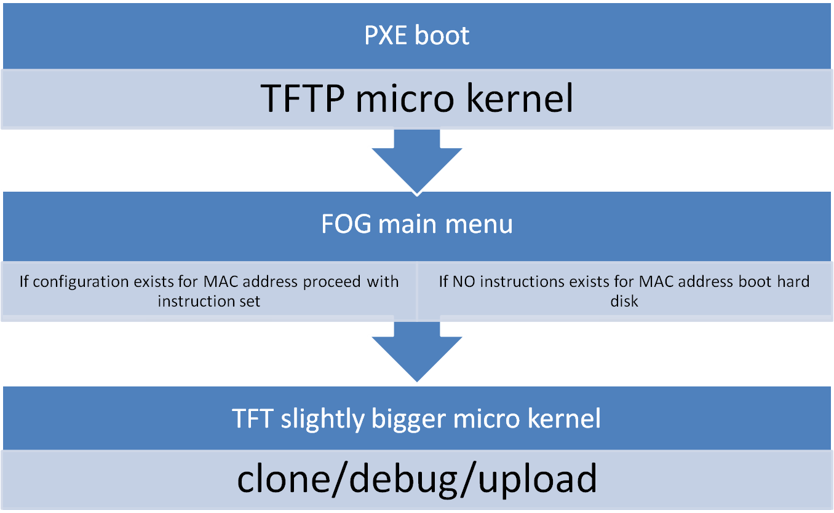
fog

Slide 3
PXE
The Preboot eXecution Environment (PXE, also known as 'pixie') is an environment to boot computers using a network interface independently of available data storage devices (like hard disks) or installed operating systems.
The firmware on the client tries to locate a PXE redirection service on the network (Proxy DHCP) in order to receive information about available PXE boot servers. After parsing the answer, the firmware will ask an appropriate boot server for the file path of a network bootstrap program (NBP), download it into the computer's Random Access Memory (RAM) using TFTP, possibly verify it, and finally execute it. If only one NBP is used among all PXE clients it could be specified using BOOTP without any need of a proxy DHCP, but a TFTP boot server is still required

Slide 4
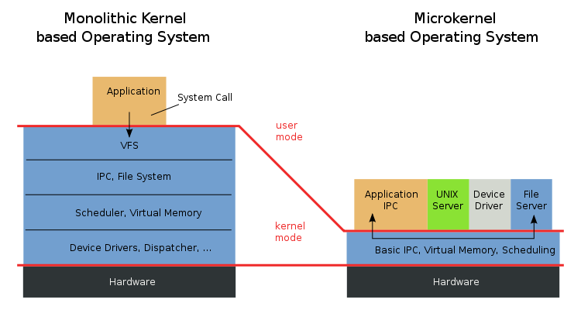
micro kernel

Slide 5
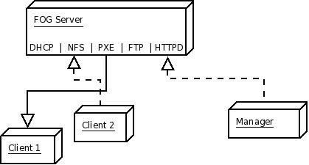
fog components
HTTPD for management (php/mysql backend)
NFS for downloading/uploading images
DHCP and PXE for booting micro kernel
FTP and TFTP for copying micro kernels and instructions

Slide 6
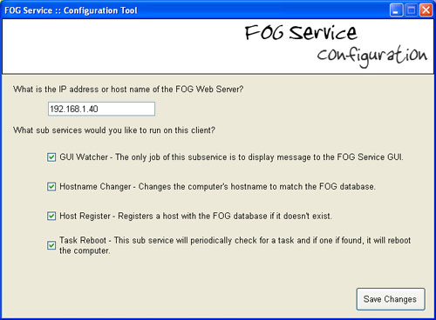
fog service for clients
Auto Log Off
Hostname Changes
Active Directory Integration
Directory Cleaner
Display Manager
Green FOG
Host registration Task Restarting
Snapin Installation
User Tracker
Printer Manager
User Cleanup
Client Updater User Tracker

Slide 7
How it works
A computer is registered either using the pxe boot menu or the web interface
Information about that computer is saved in a database
A task is assigned to that computer via web interface such as, upload/download image or debug
A configuration file for the MAC address is put into a directory where the PXE boot image loads the parameters for the assigned task
The computer is booted, linux micro kernel is loaded where a bash script does some neat stuff, including bringing up the NFS mount for image storage
In case of an image upload gzip/tar compress and create an image file which is uploaded and displayed using a fancy shell script
In case of mass distributing an image, shell script gzip/tar uncompress’ the image and distributes it using udp-sender/reciver a multicasting application.

Slide 8
benefits
Scalable
Open source
Easy to maintain and backup
Runs on relatively crappy hardware

Slide 9
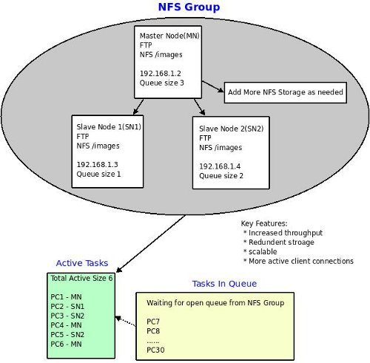
Single NFS groups

Slide 10
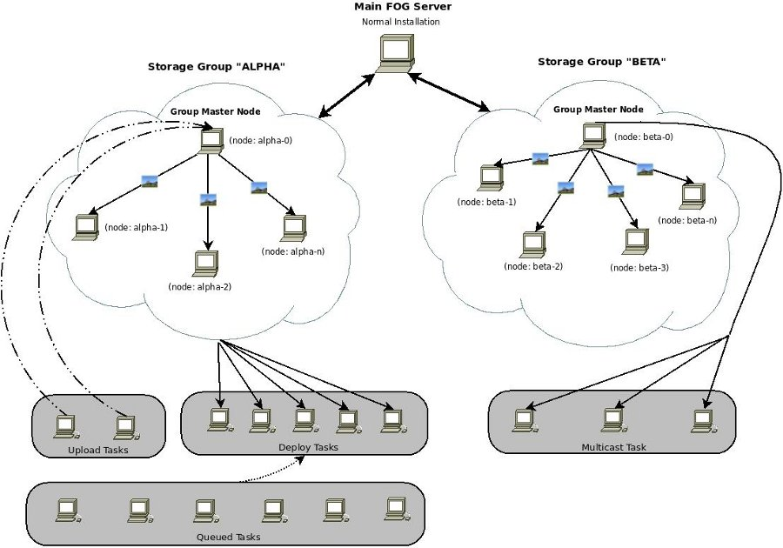
multi storage node array

Slide 11
multicasting
IP multicast is a technique for one-to-many communication over an IP infrastructure. It scales to a larger receiver population by not requiring prior knowledge of who or how many receivers there are. Multicast uses network infrastructure efficiently by requiring the source to send a packet only once, even if it needs to be delivered to a large number of receivers. The nodes in the network take care of replicating the packet to reach multiple receivers only when necessary. The most common low-level protocol to use multicast addressing is User Datagram Protocol (UDP).
Detailed information available at :
http://www.cisco.com/en/US/docs/internetworking/technology/handbook/IP-Multi.html

Slide 12
END

